Slide 1
Bug Bash
01-19-2018

Slide 2
Remove hyperlink in msg
FAQ open a new tab

Slide 3
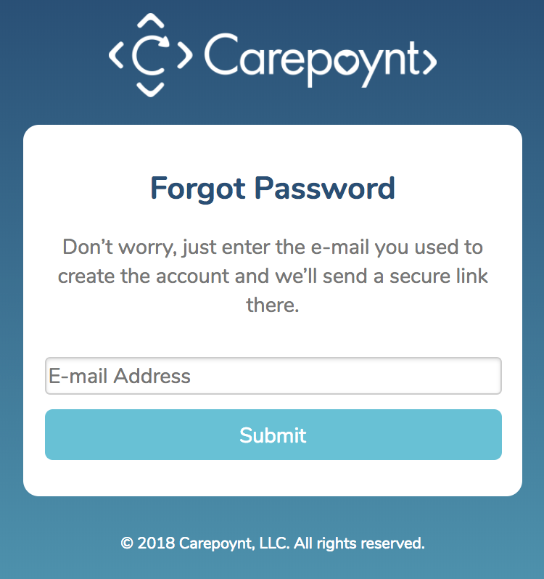
Enter the email you used to create your account and we’ll send you a secure link to reset your password.

Slide 4
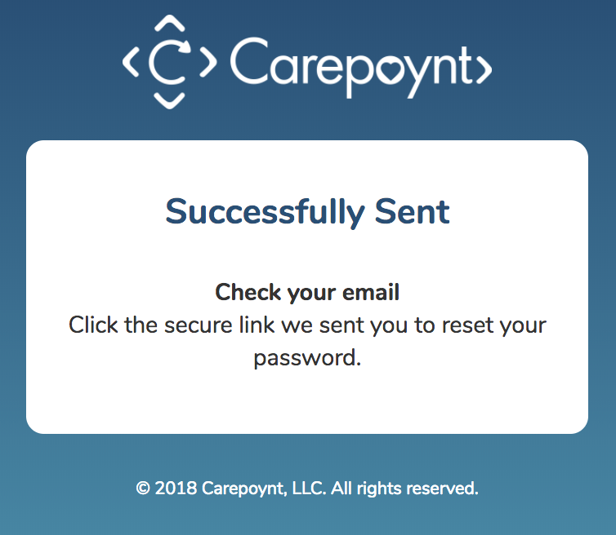
Hyperlink text. “Back to Carepoynt.com.”

Slide 5
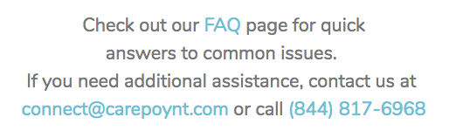
Text above the submit button in dark button teal color and centered.
Also make the button grey when disabled.
“Submit button will activate after required fields are properly filled out.”
Add support text below the submit button centered.

Slide 6
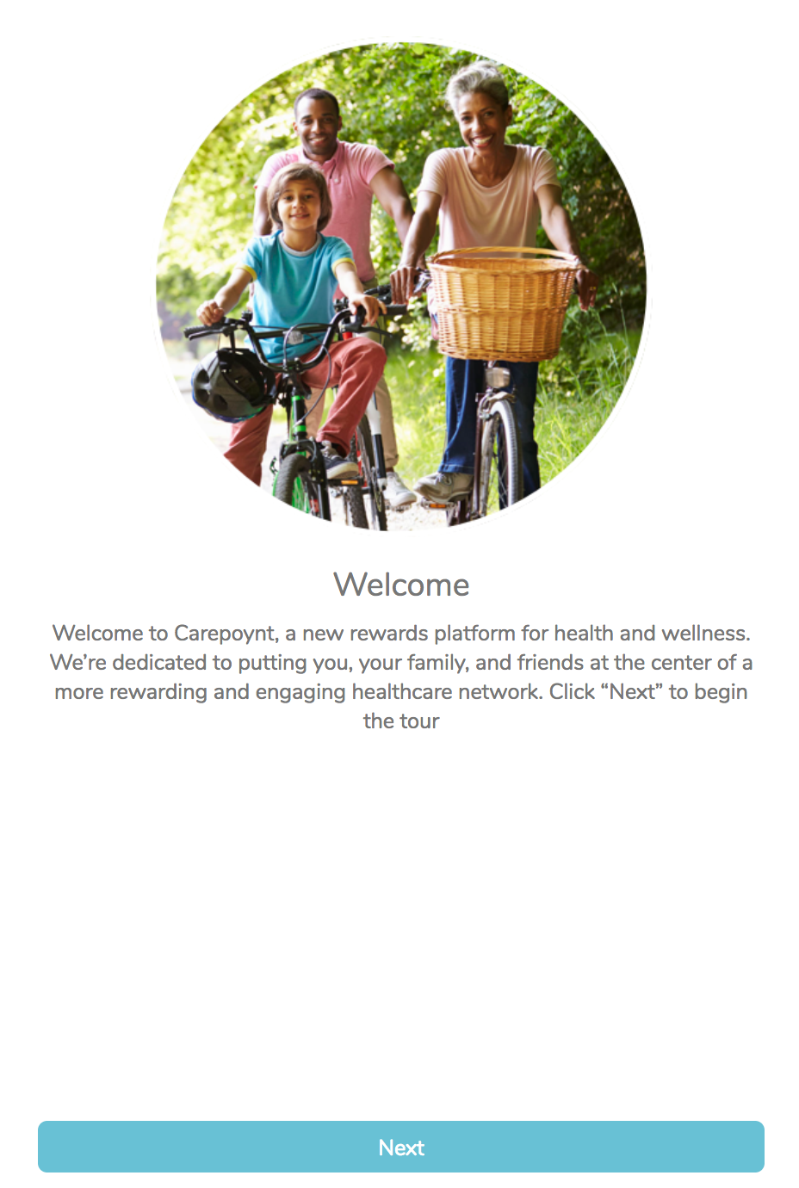


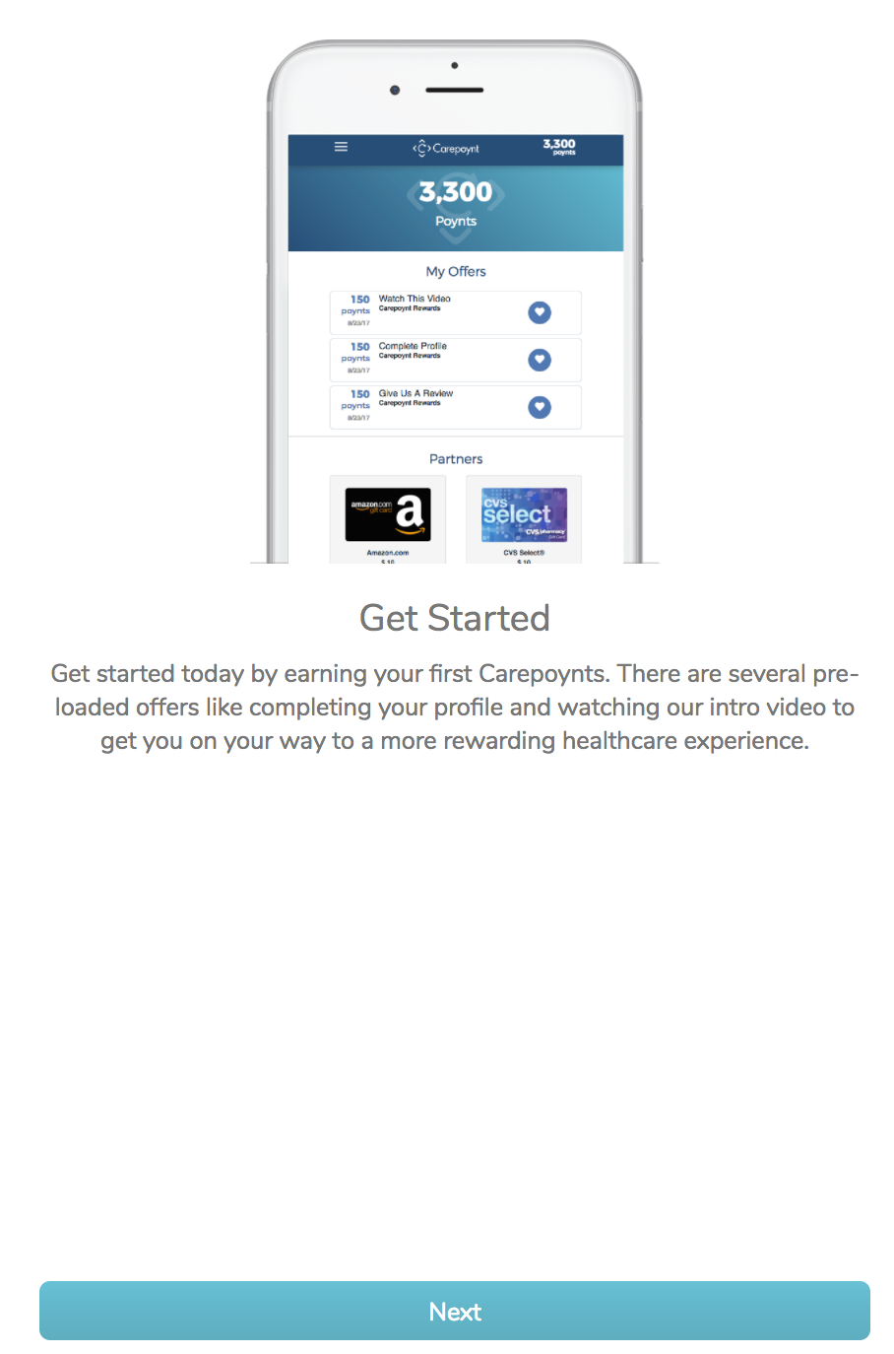
Hyperlink text. “Back to Carepoynt.com.”

Slide 7
Remove the For new Carepoynt… paragraph.
Keep the Limit one gift card … text

Slide 8
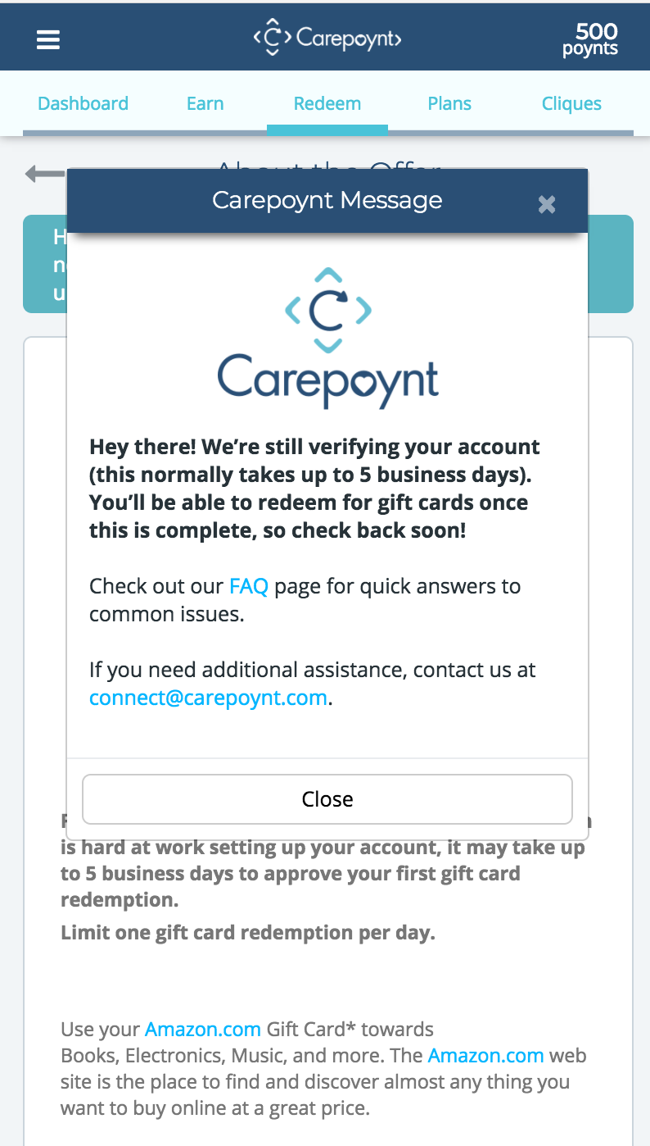
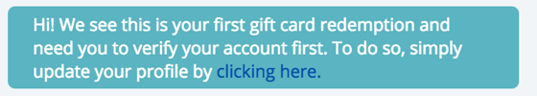
Replace “Hey there…” with the “Hi! We see…”

Slide 9
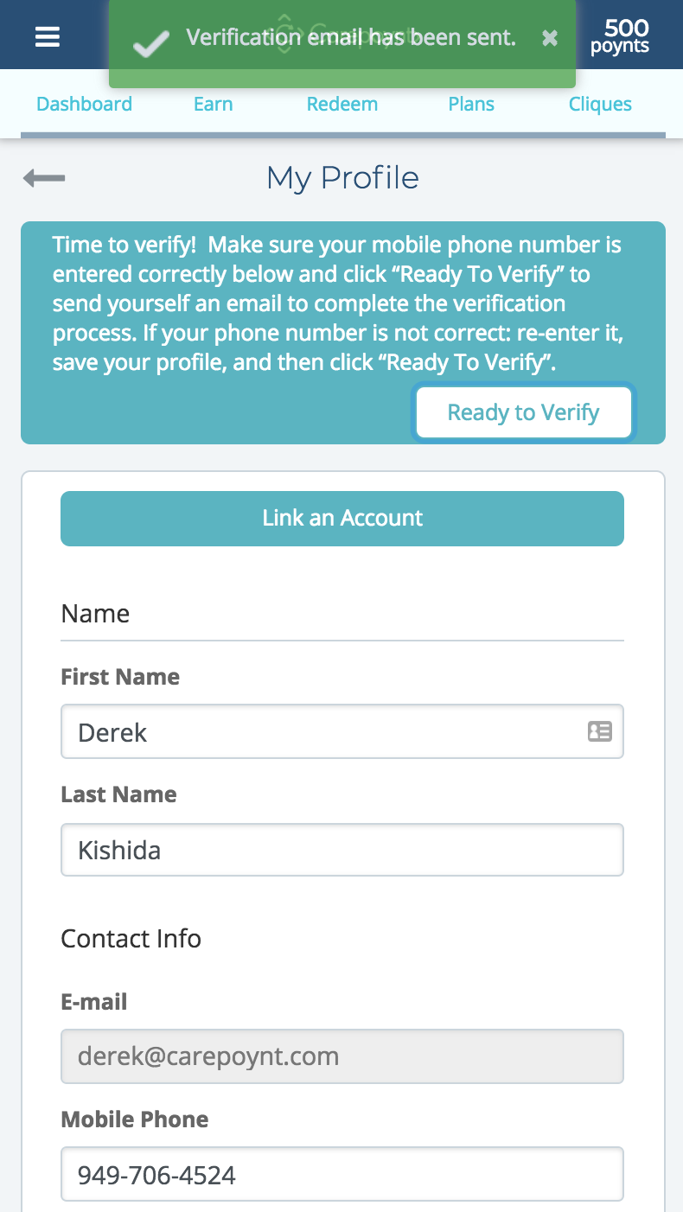
Time to verify! Is the mobile phone number below correct? Change it if you need to and click Save at the bottom. Then click Ready to Verify.

Slide 10
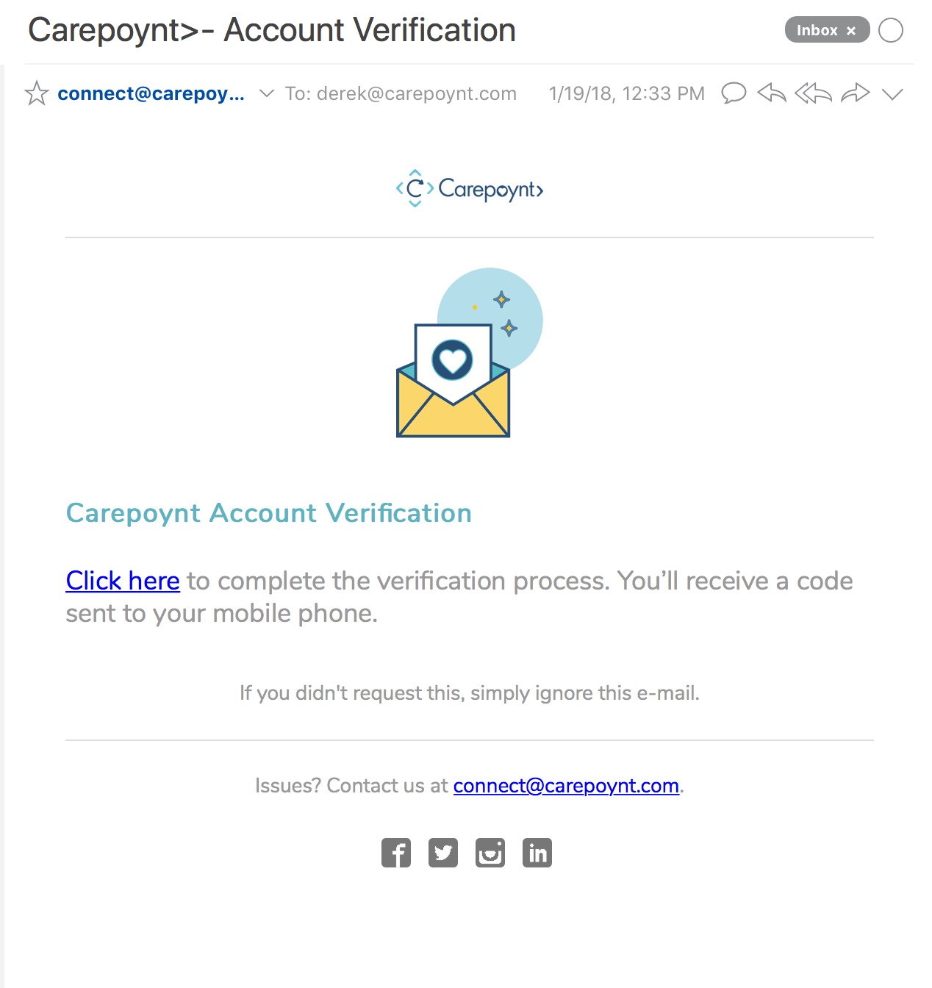
Click here to complete the verification process. A code will be sent to your mobile phone.

Slide 11
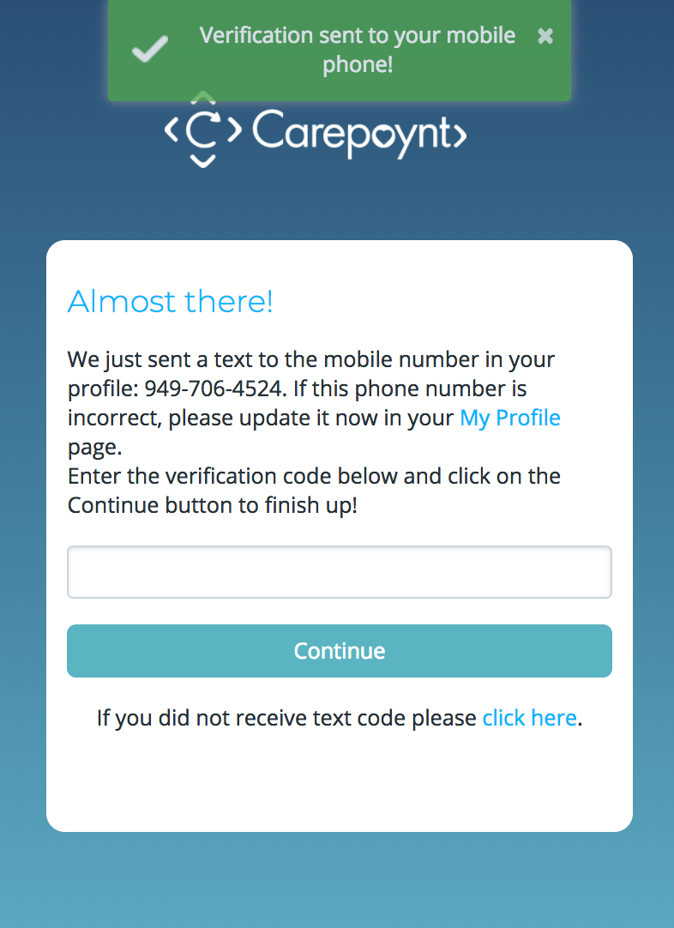
Toaster: “Verification code was sent!”
Line break after the “page.”

Slide 12
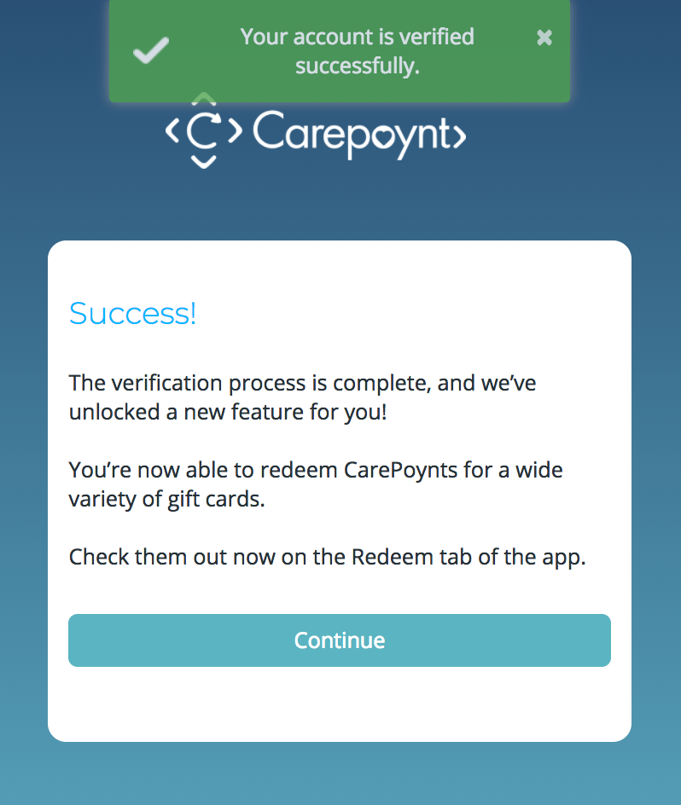
The verification process is complete!
You’re now able to earn and redeem CarePoynts for a wide variety of products and services.
Check them out now when you log in on Carepoynt.com.

Slide 13
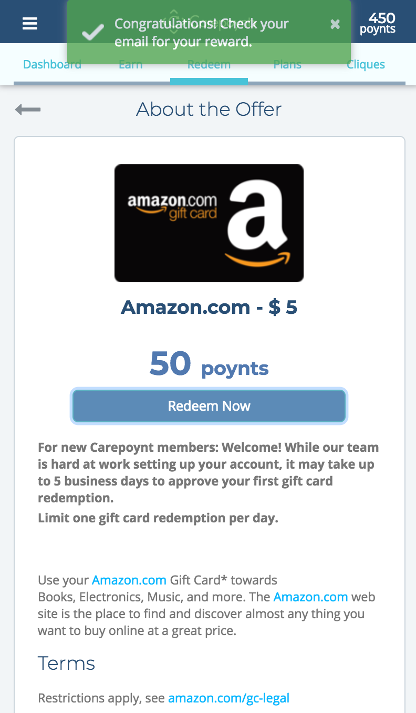
Toaster: Hurray! Your gift card has been sent to your email.

Slide 14
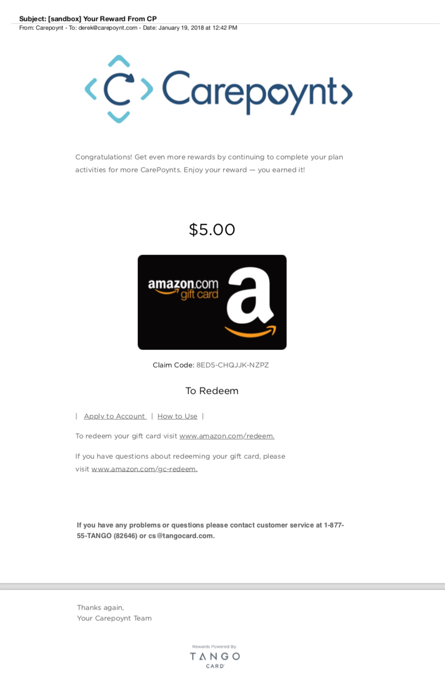
No change Tango email for now

Slide 15
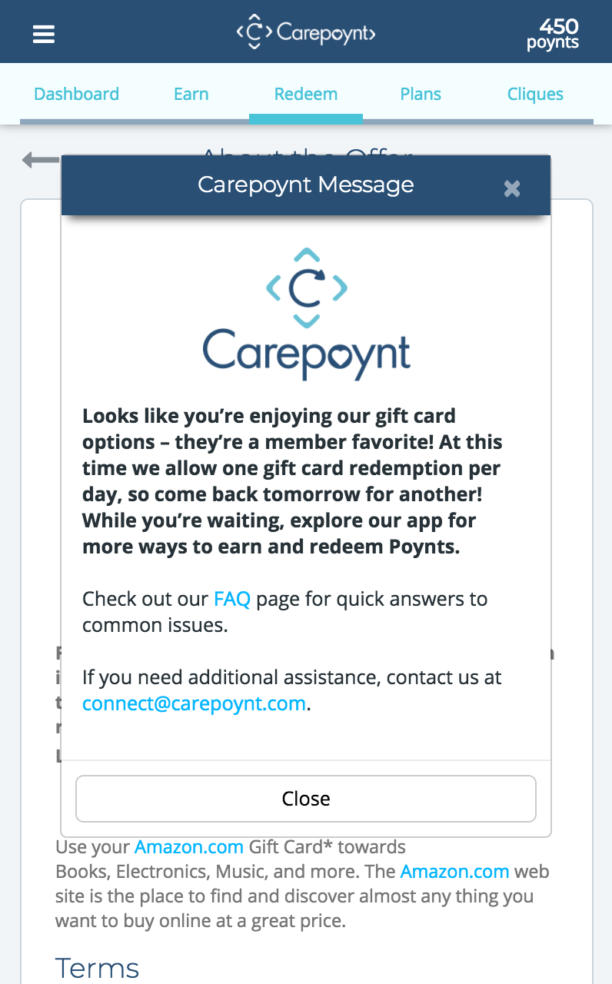
Looks like you’re enjoying our gift card options – they’re a member favorite! At this time we allow one gift card redemption per day, so come back tomorrow for another! While you’re waiting, explore our app for more ways to earn and redeem Poynts.

Slide 16
Approved

Slide 17
Approved

Slide 18
Approved

